Slide 1
Weekly meeting
2 22 2024
Ty Bottorff

Slide 2
Outline
New colitis dataset
their main findings
cell type abundance analysis
ATACseq practice: mean coverage plots

Slide 3
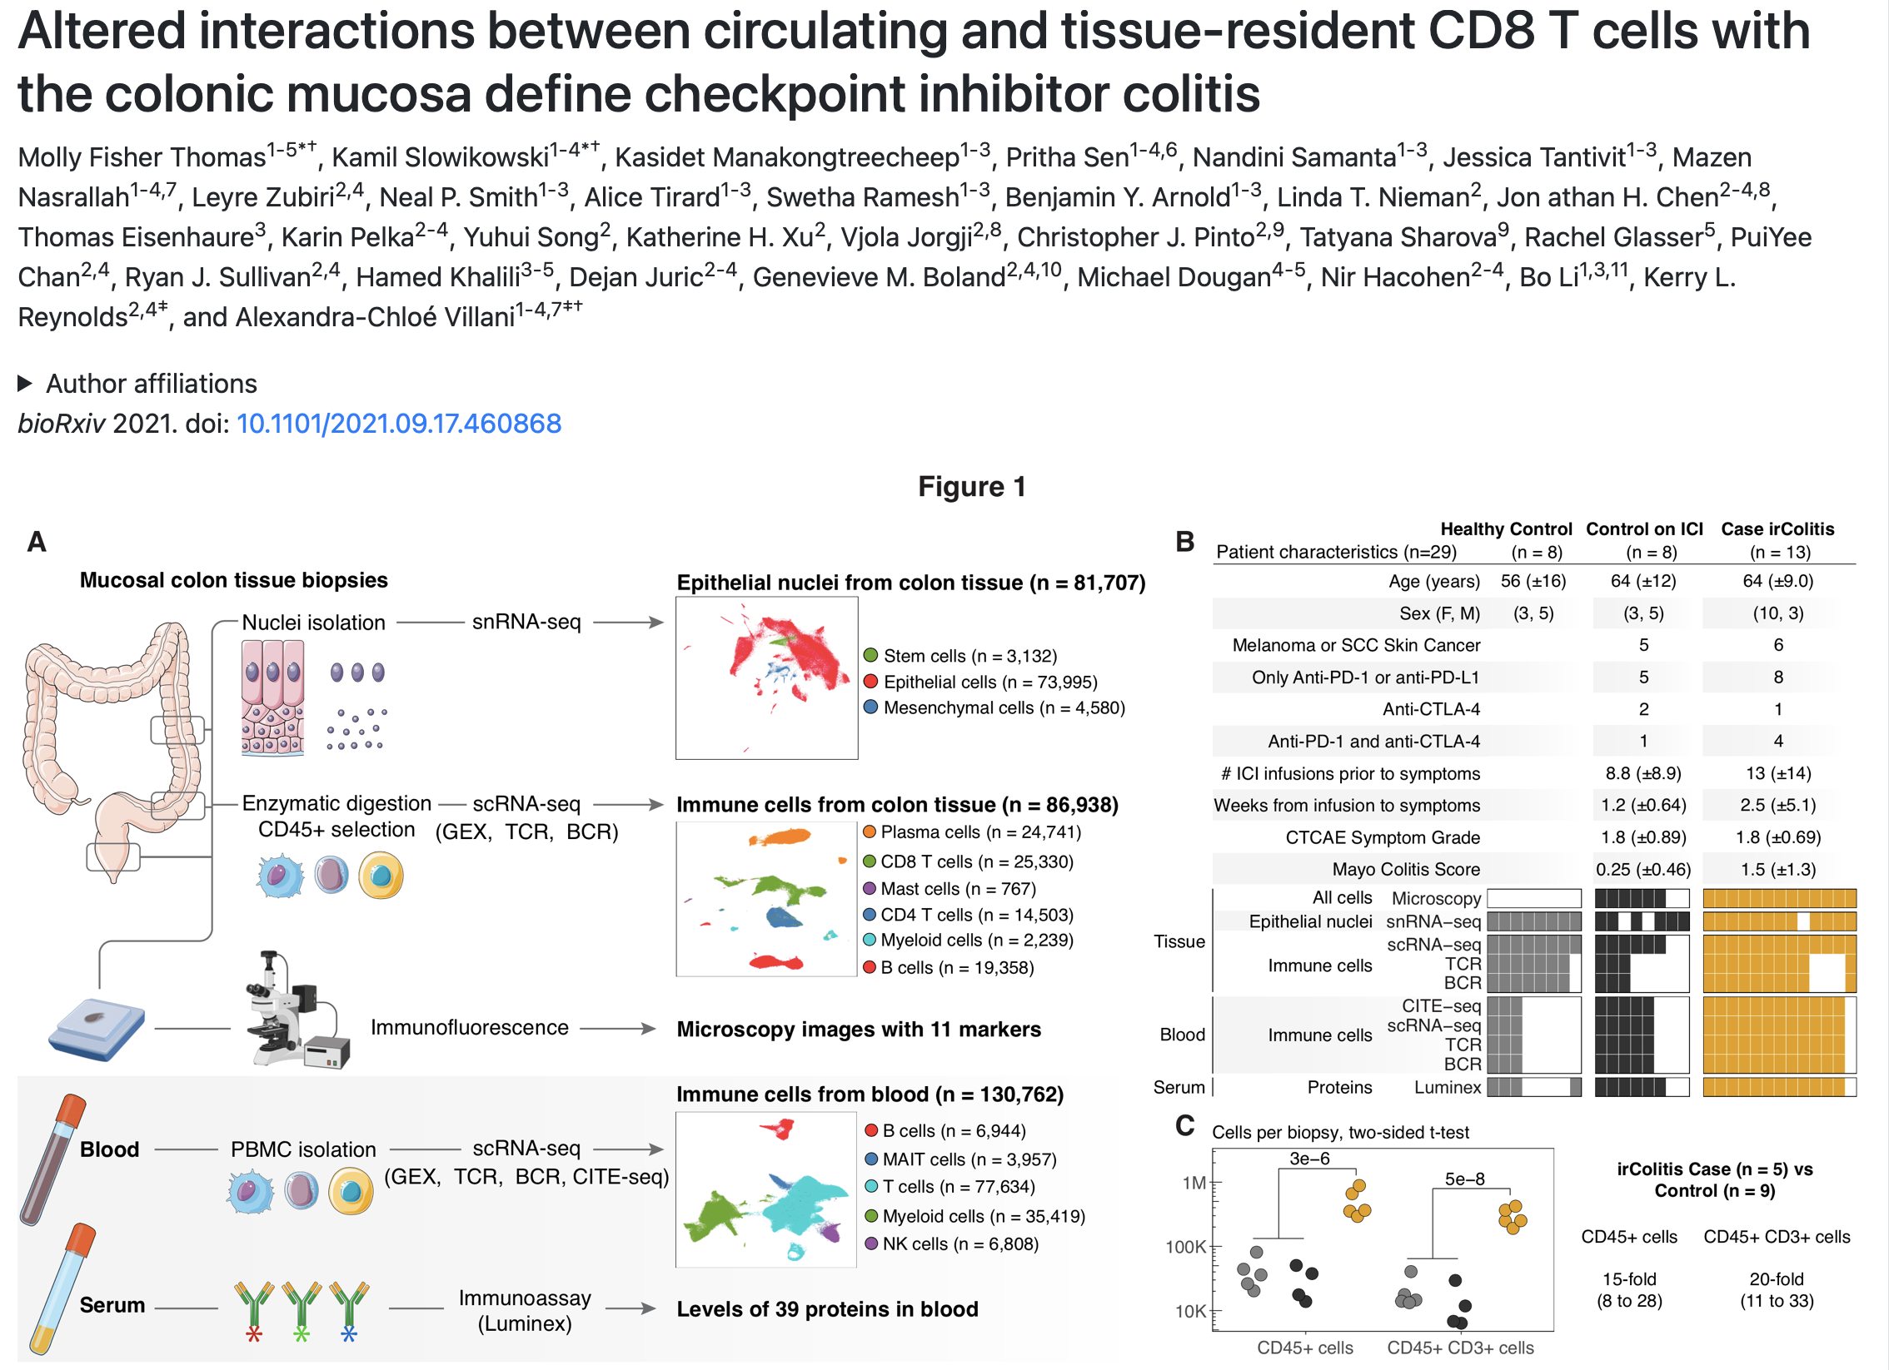
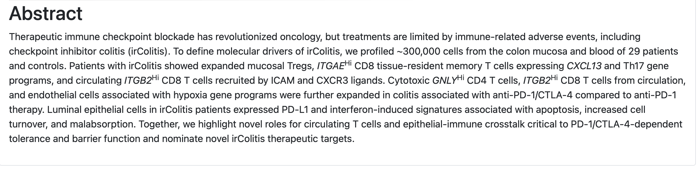
New colitis dataset
Notes:
biopsies for this study were taken from the descending colon, sigmoid, and rectum and analyzed together
most patients on ICI therapy had melanoma or lung cancer, were treated with PD-1 blockade (either as monotherapy or in combination with anti- CTLA-4), and were biopsied within two weeks of symptom onset
of the 8 control patients on ICI therapy, 4 had ICI-related gastritis and/or enteritis with sparing of the colon
used canonical genes to group immune cells into broad cell types including B cells (MS4A1, JCHAIN), T cells (CD3D, CD8A, CD4), and myeloid cells (LYZ)
HC and ICI no colitis aggregated together for all remaining analyses (didn’t see big differences between them)

Slide 4
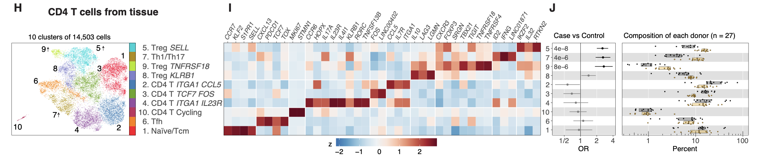
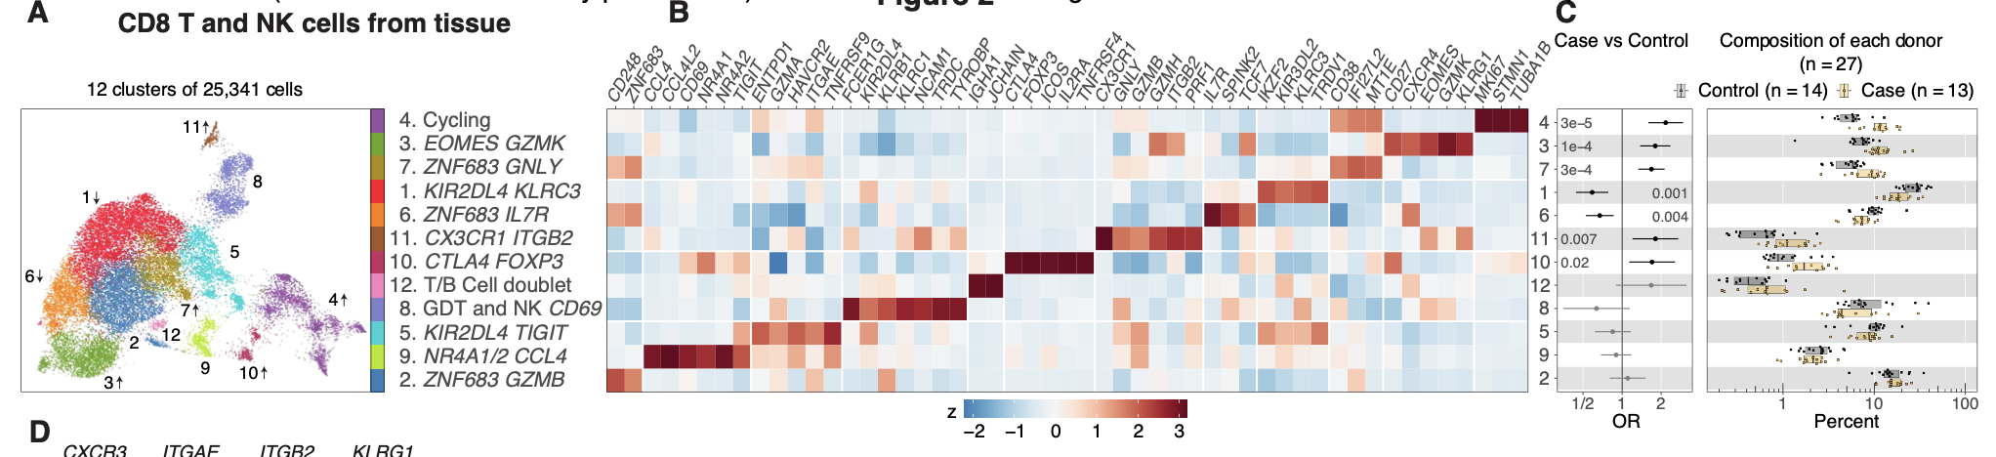
New colitis dataset (their analysis): cytotoxic CD8 T cells and CD4 Tregs are more abundant in colitis tissue
Notes:
HC and ICI no colitis aggregated together for all remaining analyses (didn’t see big differences between them)

Slide 5
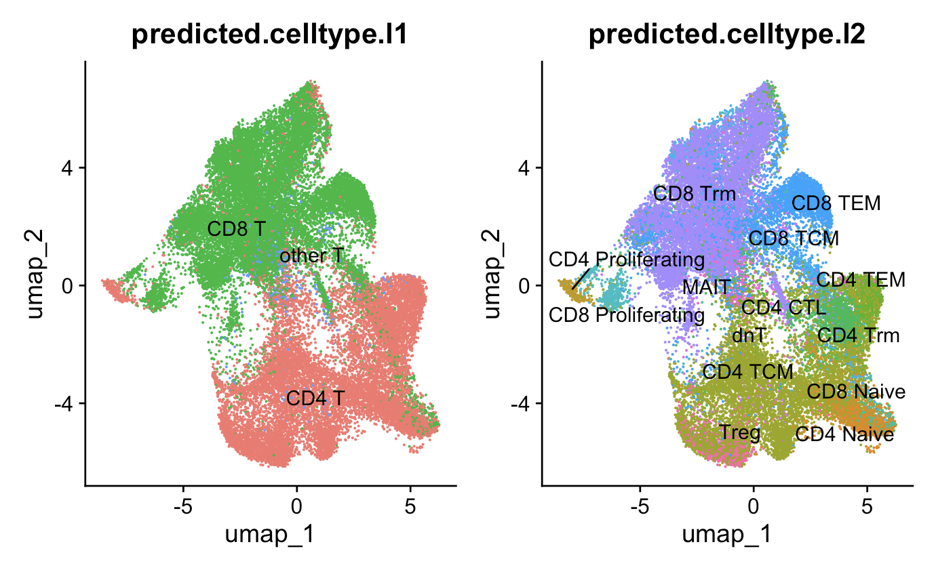
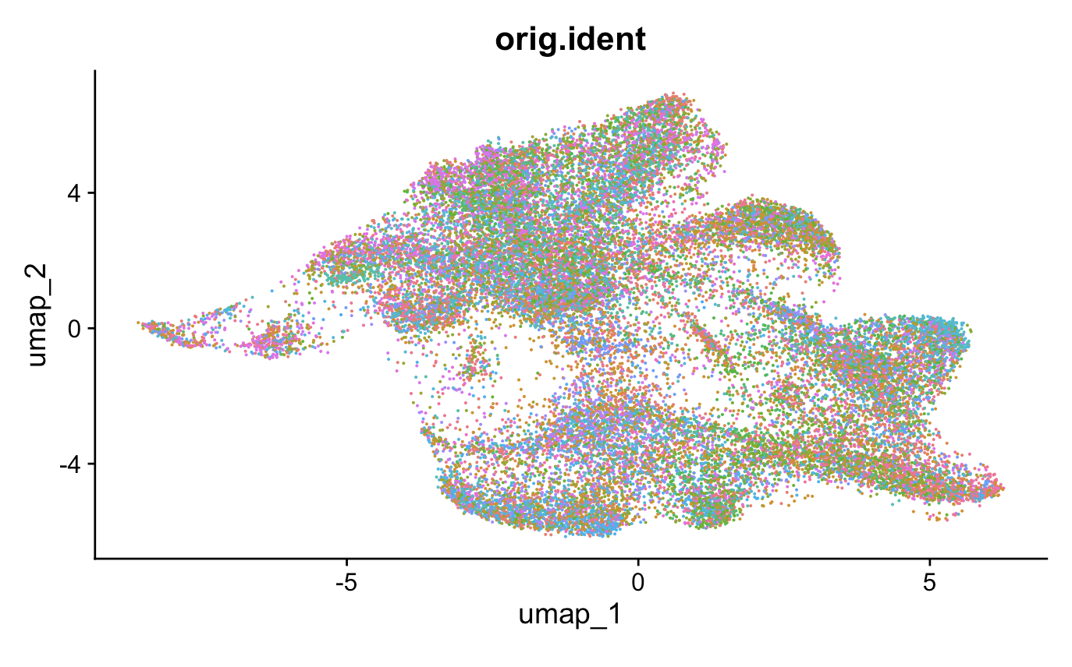
New colitis dataset (my analysis): don’t see evidence of batch effects, cell typed with Seurat

Slide 6
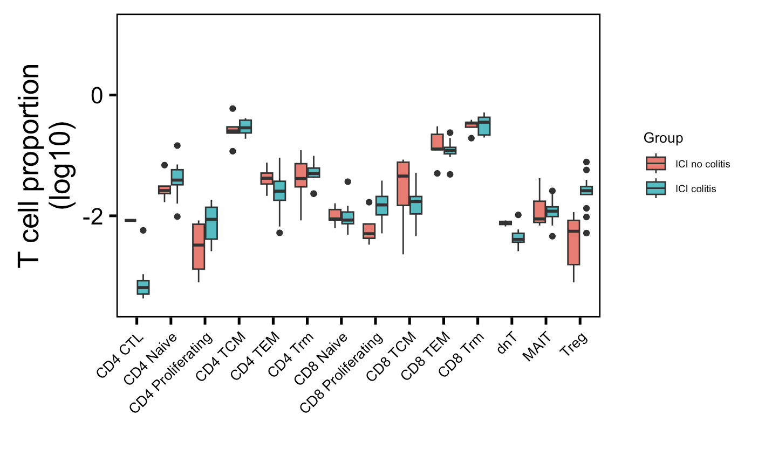
New colitis dataset (my analysis): although proliferating T cells trend up in colitis group, only Treg abundance statistically different between irAE groups (they also saw Tregs up)
*
Wilcoxon rank sum test. *, padj < 0.05

Slide 7
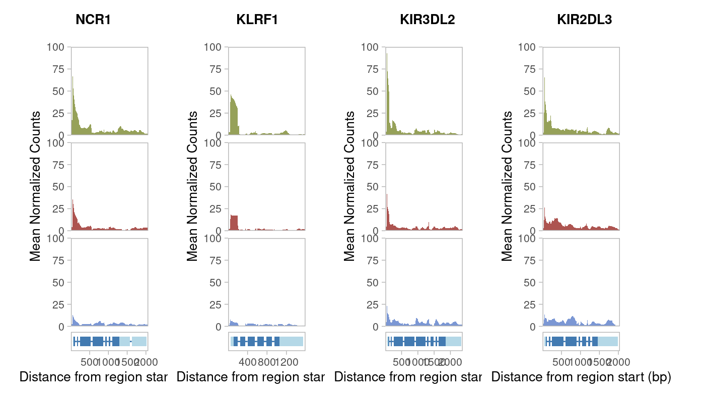
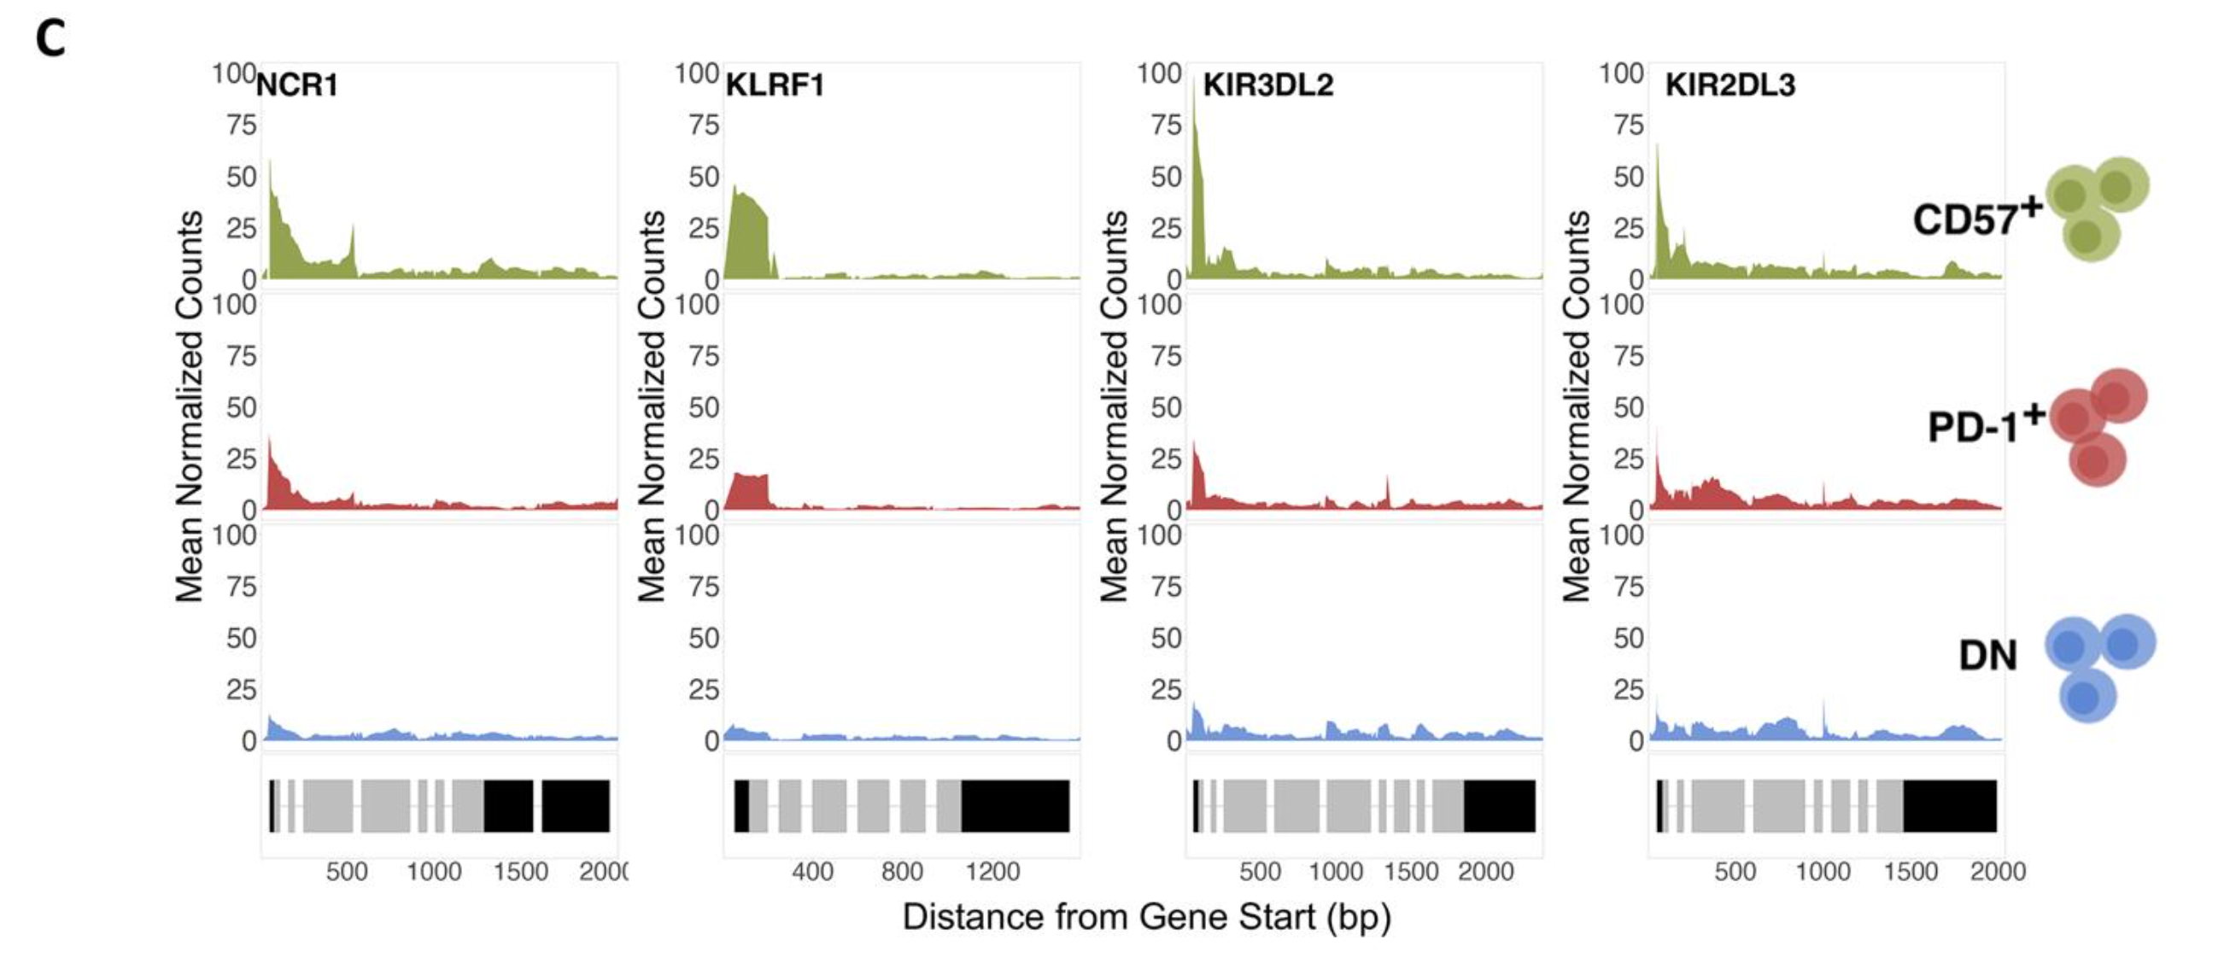
ATACseq: mean coverage plots
Erin’s
Ty’s

Slide 8
Conclusions
No differences in convergence frequencies between irAE groups by chain, cell type even among highly expanded (top 10%) T cells (old colitis dataset)
Don’t see CD4 proliferating T cells up in colitis tissue in new colitis dataset

Slide 9
Next steps
New colitis dataset
pgen and CDR3 feature analysis (pending IGoR running)
analyze PBMCs as well
Cell typing: get unicell deconvolve working and compare to other methods/references

Slide 10
Cell typing metrics (old colitis dataset)
51,396 cells & 4 methods/reference datasets used to map cell types
0% of cells have same label across all
~17% have same label across 3/4
~52% have same label across 2/4
~31% have different labels from all
Caveat: different methods/references have different names (like CD4 Th1, Th2, Th17 vs. CD4 TEM/TCM) that I can’t standardize?
Notes:
# 51396 cells
# all 4 methods agree: 0
# 3/4 methods agree: 8612
# 2/4 methods agree: 26750
# all 4 methods different: 16034

Slide 11
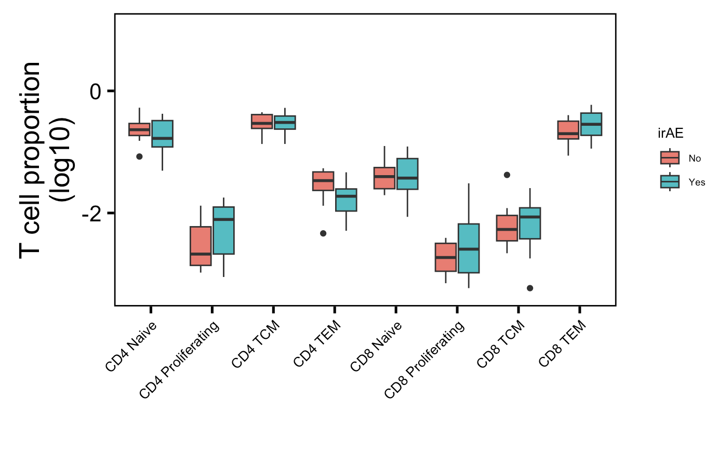
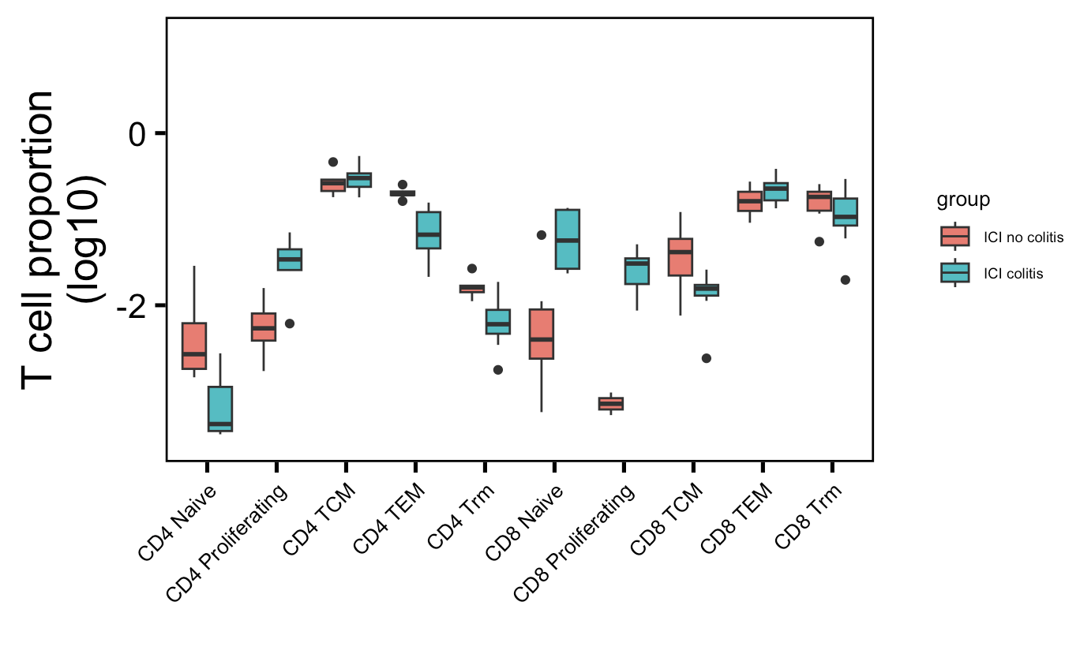
Other datasets cell abundance analyses
→
: up in their analysis
→
: down in their analysis
PBMC myocarditis-focused dataset (mostly PD-1 blockade)
Colon tissue colitis dataset (CTLA-4/combo blockade)
→
→
→
→
**
Wilcoxon rank sum test. **, padj < 1e-2

